Slide 1
Credit Risk Modeling Using Machine Learning
BCSE207L // PROGRAMMING FOR DATA SCIENCE
model <- randomForest(
Loan_Status ~ .,
data = train_data
)
# hold-out test, n = 154
accuracy =
f1 =
auc =
76.62 %
83.49 %
0.78
Explainable loan approval prediction with Random Forest, SHAP and counterfactual recourse
24BDS1112 · 24BDS1071
Vellore Institute of Technology, Chennai

Slide 2
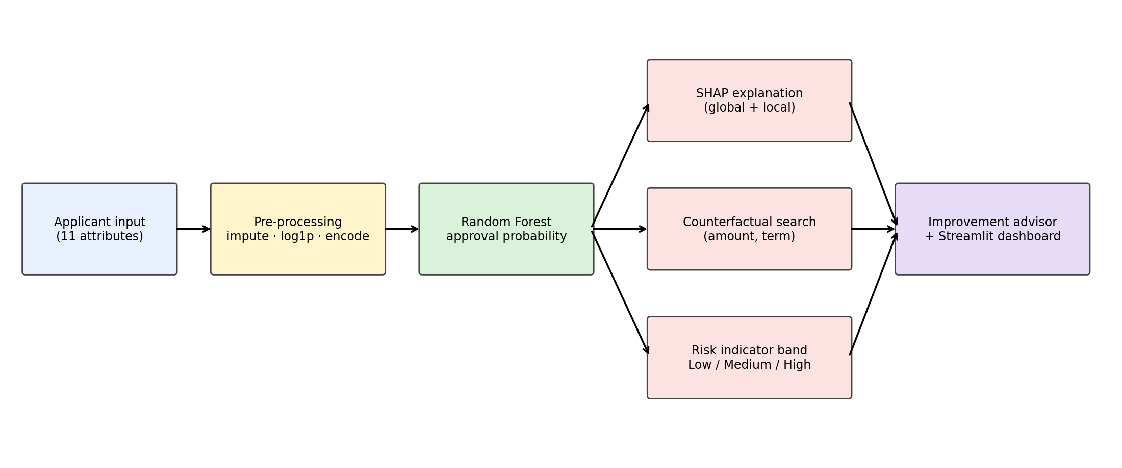
Beyond a label: explainable loan decisions
// 01 · PROBLEM & PIPELINE
01 PROBLEM
Models return approve/reject with no reason. Applicants can't improve; officers can't audit.
02 GAP
Prior work stops at feature attribution: what mattered, not what to change.
03 APPROACH
Random Forest + SHAP + counterfactuals + advisor + risk band in one Streamlit dashboard.
SHAP
COUNTERFACTUAL
RISK BAND
why it decided
what to change
how likely

Slide 3
614 applications, imbalanced and messy
// 02 · DATASET & PREPROCESSING
614
11
68.7%
149
loan records
input features
approved (422 / 192)
missing cells
PIPELINE
Impute: median (numeric), mode (categorical)
Log transform skewed income (max 81,000)
Split 75:25 → train 460, test 154
Oversample train only → 644 rows

Slide 4
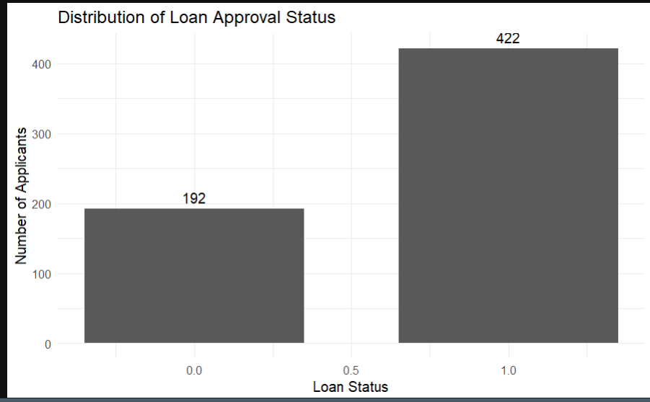
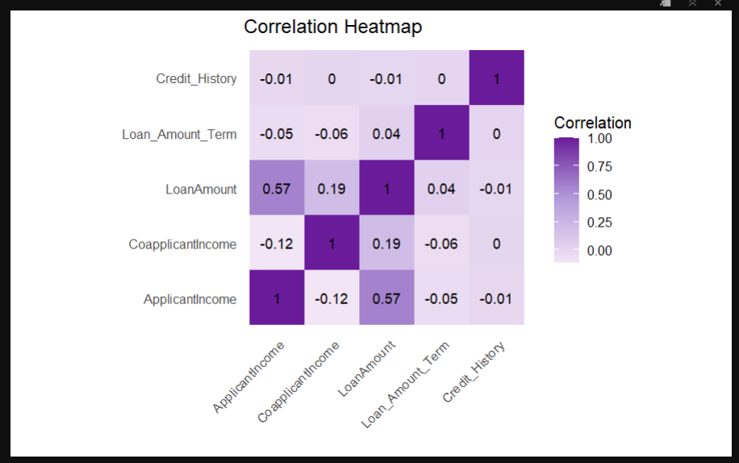
EDA: class imbalance and weak correlations
// 03 · EXPLORATORY DATA ANALYSIS
422 approved vs 192 rejected: about 2.2 to 1
Only ApplicantIncome–LoanAmount is notable (0.57)

Slide 5
Four classifiers, one pipeline
// 04 · CLASSIFIERS
LOGISTIC REG.
DECISION TREE
KNN (k = 3)
RANDOM FOREST
Baseline
Rules
Distance
Proposed
Linear log-odds model. Highly interpretable.
Threshold splits. Easy to read, prone to overfit.
Majority vote of 3 nearest applicants. Scale-sensitive.
Bagged trees, random features. Gives probabilities and exact TreeSHAP.
Default hyperparameters (k = 3 for KNN), fixed seed 42, trained on the oversampled training set.

Slide 6
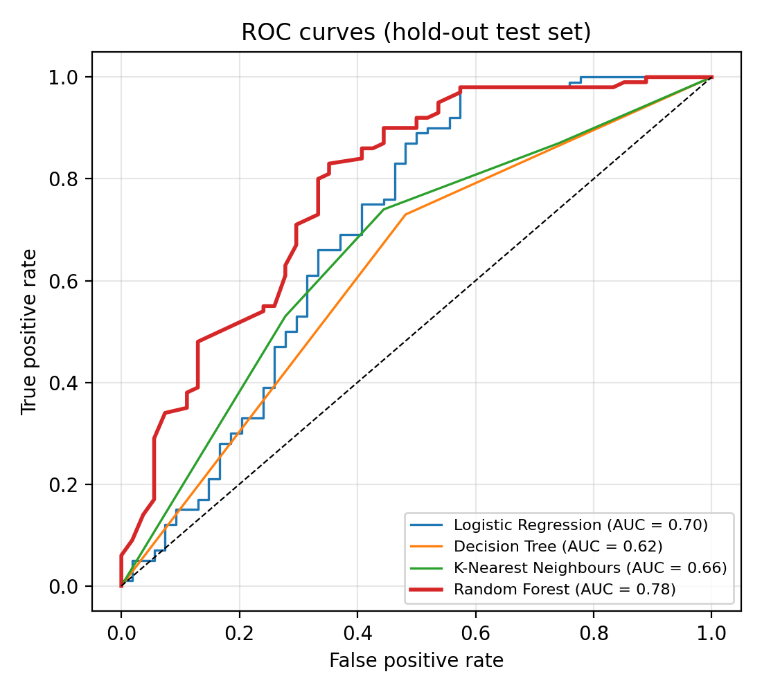
Random Forest wins on AUC: 0.78
// 05 · MODEL COMPARISON
5-fold CV: accuracy 75.89 ± 2.57%, AUC 0.76 ± 0.02. Gap to Logistic Regression is within noise at n = 154.

Slide 7
Hold-out test results (n = 154)
// 06 · HOLD-OUT RESULTS
Model | Acc % | Prec % | Rec % | F1 % | Spec % | AUC
Logistic Regression | 75.32 | 75.41 | 92.00 | 82.88 | 44.44 | 0.70
Decision Tree | 65.58 | 73.74 | 73.00 | 73.37 | 51.85 | 0.62
K-Nearest Neighbours | 67.53 | 75.51 | 74.00 | 74.75 | 55.56 | 0.66
Random Forest (proposed) | 76.62 | 77.12 | 91.00 | 83.49 | 50.00 | 0.78
Green marks the best value per column. Random Forest leads on accuracy, F1 and AUC.
All models favour approvals: high recall, specificity near 50%.

Slide 8
5-fold stratified CV (mean ± std)
// 07 · CROSS-VALIDATION
Model | Acc % | Prec % | Rec % | F1 % | Spec % | AUC
Logistic Regression | 75.58 ± 4.37 | 79.27 ± 0.96 | 87.21 ± 7.04 | 82.97 ± 3.67 | 49.97 ± 2.75 | 0.71 ± 0.05
Decision Tree | 71.16 ± 3.30 | 79.11 ± 1.36 | 78.89 ± 6.09 | 78.90 ± 3.21 | 54.16 ± 5.09 | 0.67 ± 0.02
K-Nearest Neighbours | 69.05 ± 2.91 | 78.49 ± 2.00 | 75.81 ± 5.04 | 77.04 ± 2.78 | 54.09 ± 7.37 | 0.69 ± 0.02
Random Forest (proposed) | 75.89 ± 2.57 | 79.51 ± 0.74 | 87.42 ± 4.14 | 83.25 ± 2.19 | 50.51 ± 1.99 | 0.76 ± 0.02
RF and Logistic Regression are indistinguishable on accuracy; RF has the higher, steadier AUC.
Oversampling was applied inside each training fold only.

Slide 9
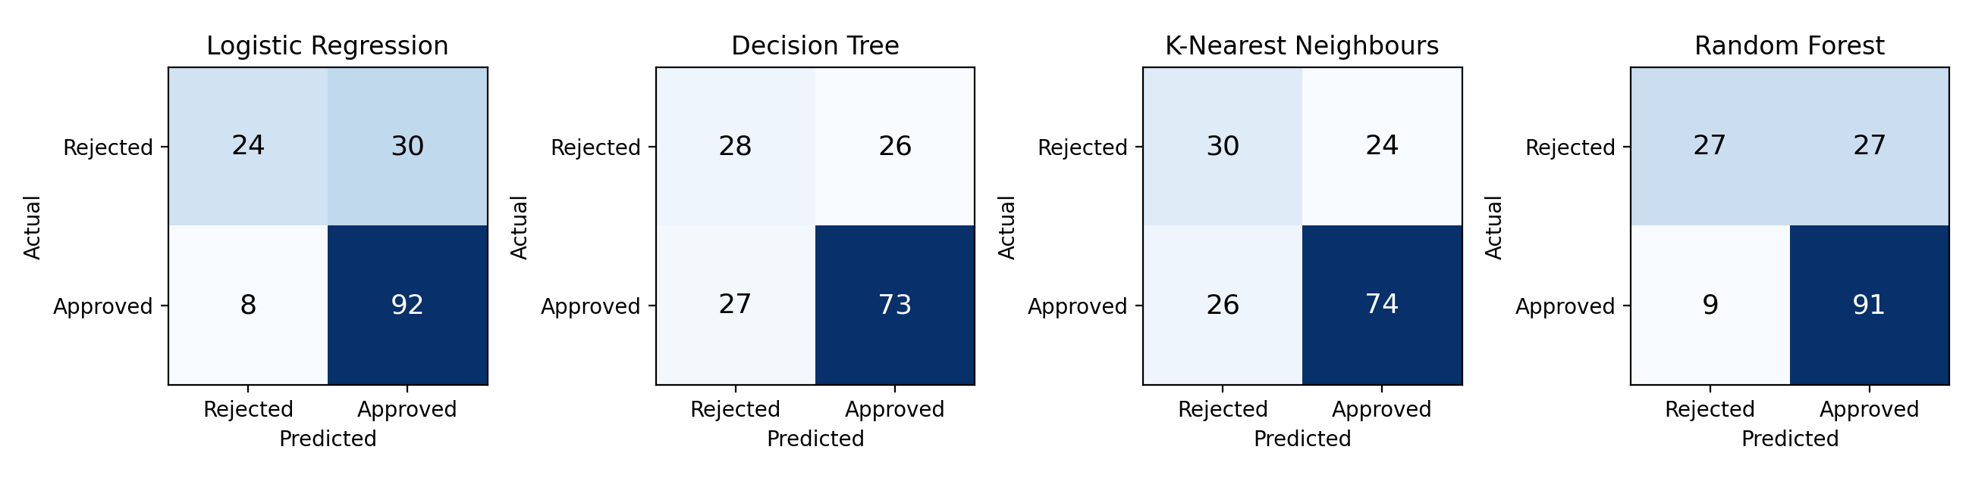
Where each model errs
// 08 · CONFUSION MATRICES
Logistic Reg.
Decision Tree
KNN (k = 3)
Random Forest
FP 30 · FN 8
FP 26 · FN 27
FP 24 · FN 26
FP 27 · FN 9

Slide 10
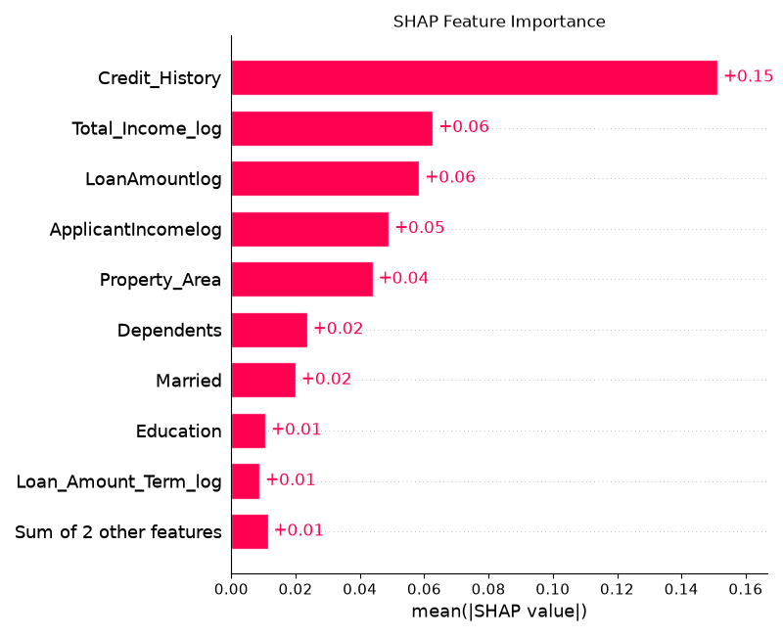
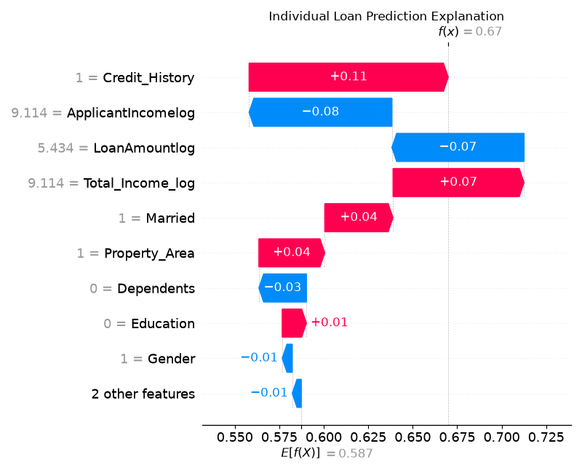
SHAP: credit history dominates decisions
// 09 · SHAP EXPLAINABILITY
Global: Credit_History 0.15, about 2.5× the next feature
Local: one applicant, p = 0.67 (Medium band)

Slide 11
From explanation to recourse
// 10 · COUNTERFACTUALS & RISK BANDS
6 / 35
rejected applicants flipped to approved (17.1%)
−23.1%
mean loan reduction needed (range 9.3–49.7%)
0.447→0.517
mean approval probability, before → after
23 of 35 rejections have poor credit history; no loan change offsets it.

Slide 12
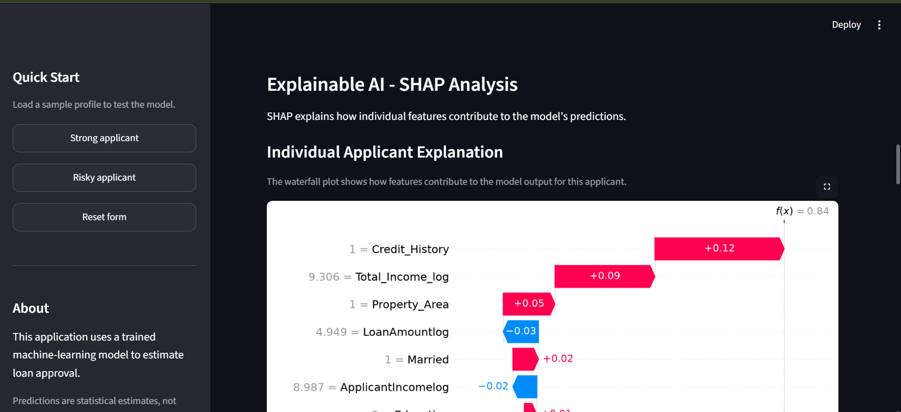
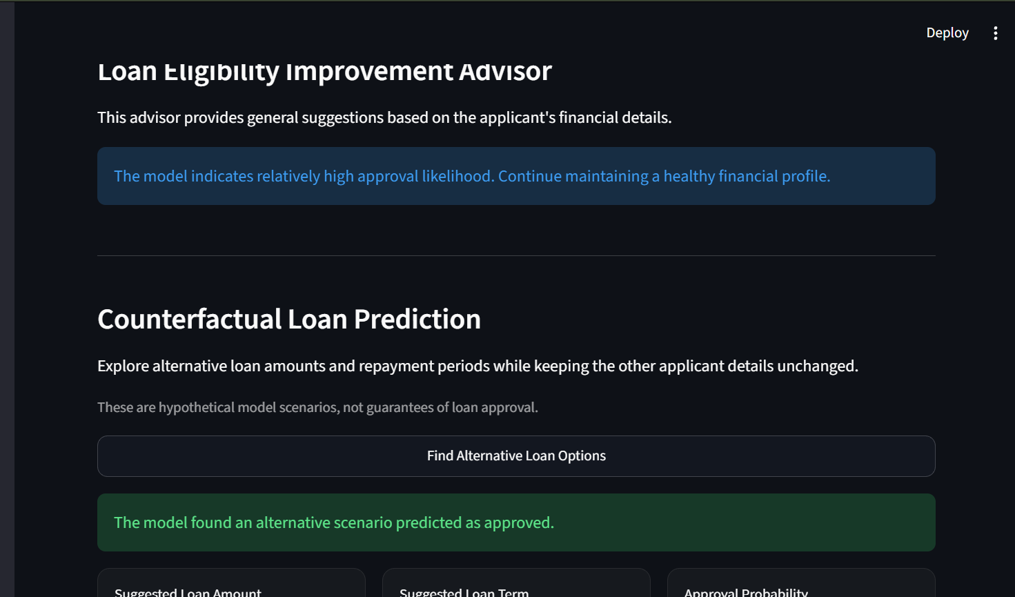
Streamlit app for non-technical users
// 11 · INTERACTIVE DASHBOARD
Inputs → decision, probability, risk band, EMI summary, SHAP plots, counterfactuals and plain-language advice.

Slide 13
Limits and what comes next
// 12 · LIMITATIONS & NEXT STEPS
LIMITATIONS
TAKEAWAYS & NEXT
Small data: 154 test rows, CV std 2–4 points
Specificity ≈ 50%: not for unsupervised decisions
Gender and marital status are inputs; historical bias can carry over
Bands show approval likelihood, not default risk
The contribution is the integrated framework, not an accuracy jump
Validate on larger multi-lender data; audit fairness
Widen counterfactuals to credit history and co-applicant income
Test gradient boosting with the same explainers

